Slide 1
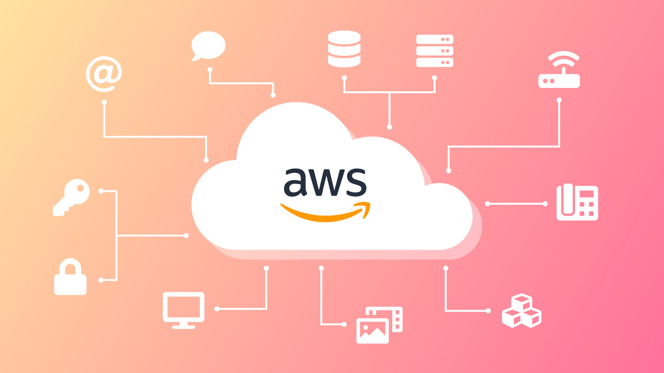

Introduction to AWS Organizations

Slide 2
What is AWS Organizations?
AWS Organizations is a service that enables you to centrally manage and govern multiple AWS accounts.
It allows you to automate the creation of new AWS accounts, apply policies for governance, and simplify billing processes through consolidated billing.
AWS Organizations is crucial for enterprises and organizations that need to manage complex, multi-account environments.

Slide 3
Why is it important?
Centralized control over security, compliance, and billing.
Scalability: Easily manage large numbers of AWS accounts as your organization grows.
Streamlines account management and reduces administrative overhead.

Slide 4
Key Features of AWS Organizations
Hierarchical Account Management
Organizational Units (OUs) allow you to group accounts in a hierarchical structure based on function, department, or project.
OUs provide a way to apply policies and permissions at different levels of the organization.
Service Control Policies (SCPs)
SCPs are used to manage permissions across accounts. They define what actions are allowed or denied within the AWS accounts in your organization.
Example: Use SCPs to enforce compliance by restricting access to certain services or regions.
Consolidated Billing
All accounts in an organization are billed together, simplifying the billing process.
Cost benefits include volume discounts and the ability to share Reserved Instances across accounts.

Slide 5
Structure of AWS Organizations
Root Organization
The Root is the top-level container in AWS Organizations.
It is the starting point for creating and managing the entire organization.
The Root can have multiple Organizational Units (OUs) under it, each containing multiple AWS accounts.

Slide 6
Organizational Units (OUs)
OUs are subgroups within your organization that allow you to organize accounts by business units, departments, or projects.
Each OU can have its own SCPs, allowing different policies to be applied at different levels.
OUs provide a flexible way to structure your organization, enabling targeted policy application.
Accounts
AWS accounts are individual entities within the organization. Each account is isolated from others, allowing for separate resources and permissions.
Accounts can be created directly under the Root or within specific OUs.
Individual accounts can have different purposes, such as development, testing, or production.

Slide 7
Creating and Managing AWS Organizations
Creating an Organization.
Steps to create an AWS Organization:
Sign in to the AWS Management Console.
Navigate to AWS Organizations and choose "Create organization."
Choose between enabling all features or only consolidated billing.
Start adding AWS accounts to your organization.

Slide 8
Adding AWS Accounts
AWS accounts can be added by inviting existing accounts or creating new ones within the organization.
When you invite an existing account, the account owner must approve the invitation.
Managing OUs and Accounts
Move accounts between OUs by dragging and dropping within the AWS Management Console.
Apply SCPs to OUs to enforce governance and control at various levels.
Use tagging and naming conventions to keep your accounts organized.

Slide 9
Service Control Policies (SCPs)
What are SCPs?
SCPs are JSON-based policies that define the maximum permissions for member accounts in your organization.
SCPs do not grant permissions but rather set boundaries within which IAM policies must operate.
SCPs are enforced at the account level, meaning that all users, roles, and root users in an account are subject to the SCPs applied to that account's OU.

Slide 10
How to Create and Apply SCPs
Create SCPs in the AWS Management Console or by using AWS CLI.
Example: An SCP that denies access to specific AWS services, such as ec2:StopInstances, can be applied to prevent users from stopping EC2 instances.
Apply SCPs at the Root, OU, or account level.
Examples of SCPs
Restricting Services: An SCP that denies the s3:DeleteBucket action across all accounts in an OU.
Enforcing Compliance: An SCP that restricts the use of AWS regions to only those approved by your organization.
Security Policies: An SCP that denies the creation of security groups that allow SSH access from the internet.

Slide 11
Real-World Use Cases
Enterprise Multi-Account Setup
Large enterprises often structure their AWS Organizations by department or business unit, with each having its own set of accounts.
Example: A financial institution might have separate OUs for Retail Banking, Investment Banking, and Compliance, each with its own accounts and policies.
SCPs can be used to enforce strict security controls across sensitive areas such as compliance and auditing.

Slide 12
Startups and Small Businesses
Startups may use AWS Organizations to manage separate accounts for development, testing, and production environments.
Consolidated billing helps startups manage costs effectively by leveraging volume discounts.
OUs can be used to separate projects or clients, ensuring that resources and costs are properly allocated.
Managed Service Providers (MSPs)
MSPs can use AWS Organizations to manage multiple client accounts under a single organization.
This allows for centralized management, monitoring, and billing of client environments.
MSPs can apply custom SCPs to enforce best practices and compliance across client accounts.

